Slide 1
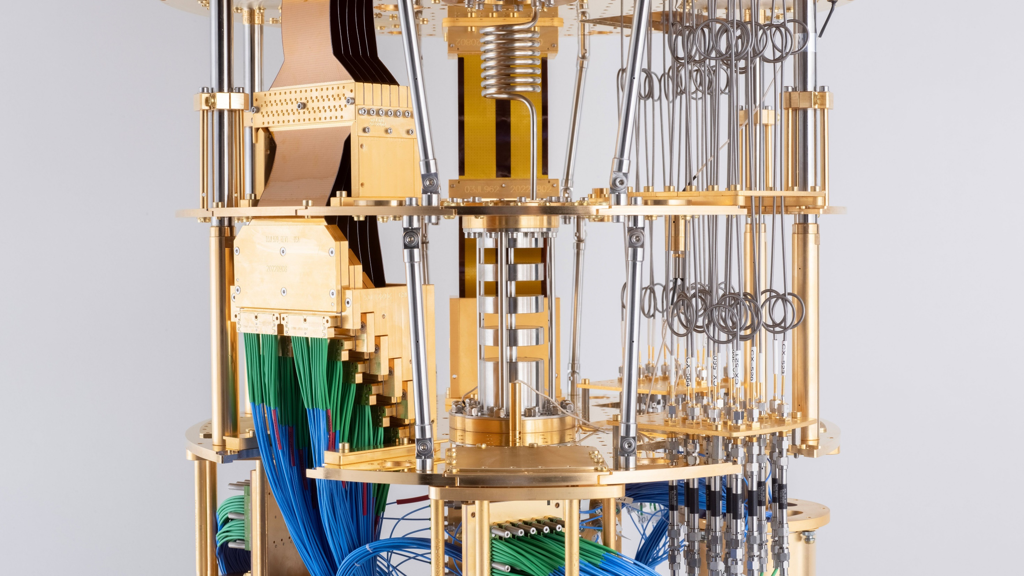




Welcome to the Wisconsin Quantum Computing Club!
Scan here for email updates and to join our Discord server.

Slide 2
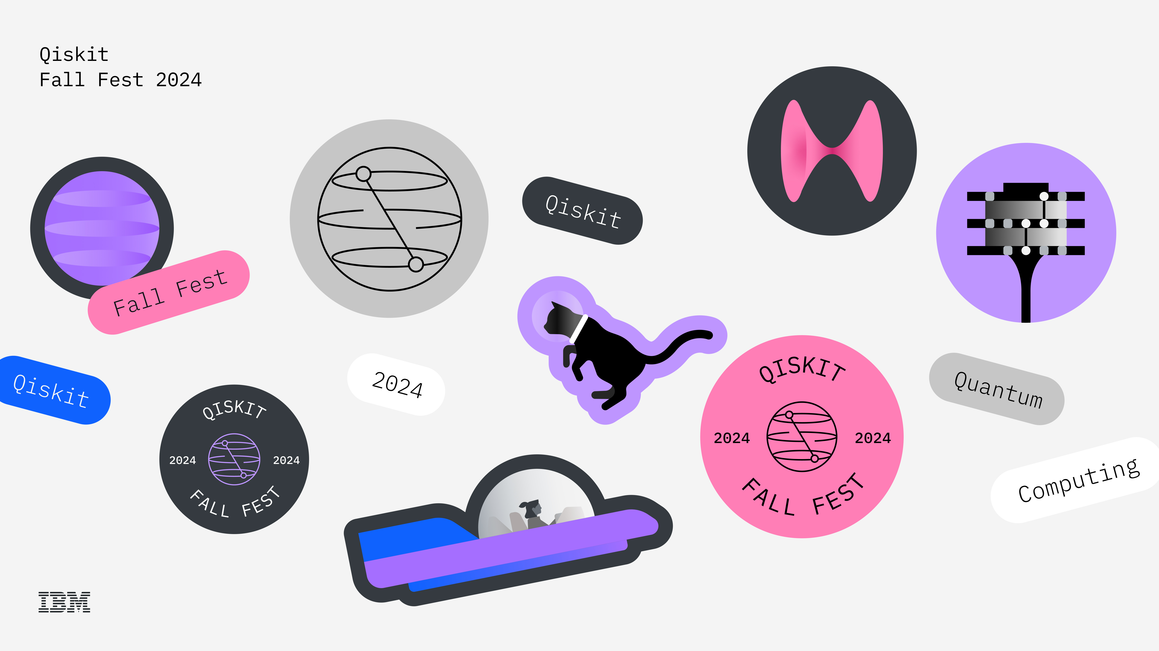
The IBM Qiskit Fall Fest is Back!
Notes:
Notes

Slide 3


IBM Qiskit Fall Fest X WQCC 2024 Roadmap
October 10
October 17
Introduction
To Quantum Mechanics
Quantum Mechanics Workshop
Coding
Workshop
Theory
October 2
November 2
November 5
November 7
Qiskit 101
Invited Speaker:
Matt Otten
October 24
Hackathon Kickoff
Hackathon Study Hall
IBM Speakers
& Hackathon
Close
Application
Closing & Awards Ceremony
October 29
Quantum Optimization
November 14
Software
*Schedule is subject to change! Make sure to check Discord or an email from the WQCC about event updates, location, and time.

Slide 4
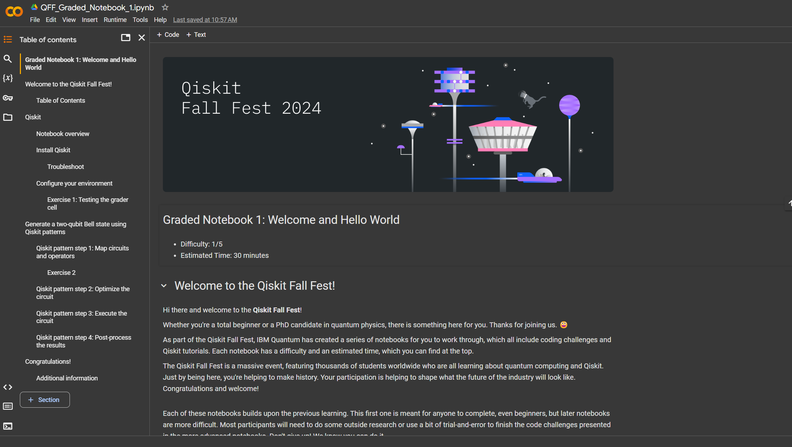
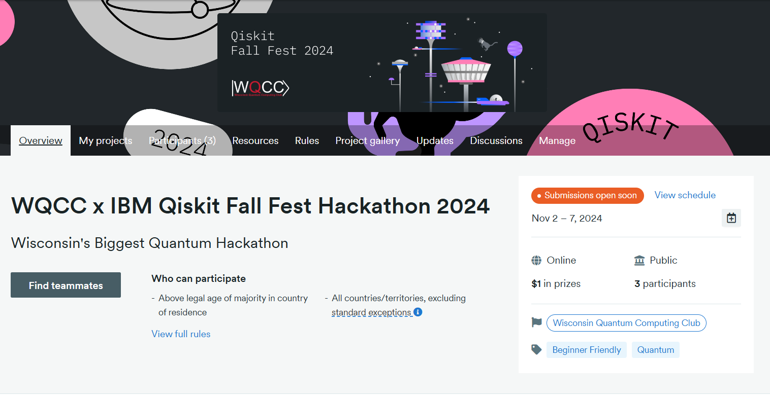
Quantum Hackathon
3 Qiskit Challenges
Due: Nov 7 at 11:59 pm
Open-ended Qiskit Project
Due:Nov 7 at 11:59 pm
Notebook 1
Notebook 2
Notebook 3

Slide 5
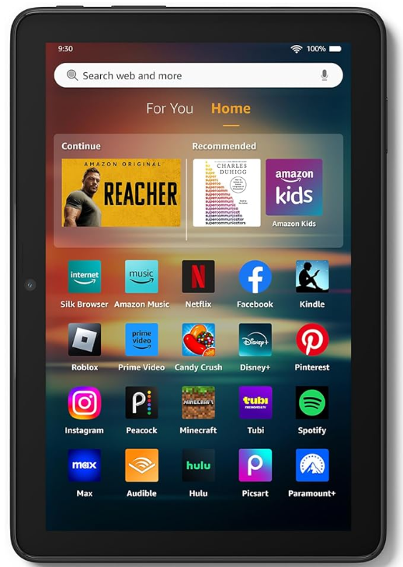
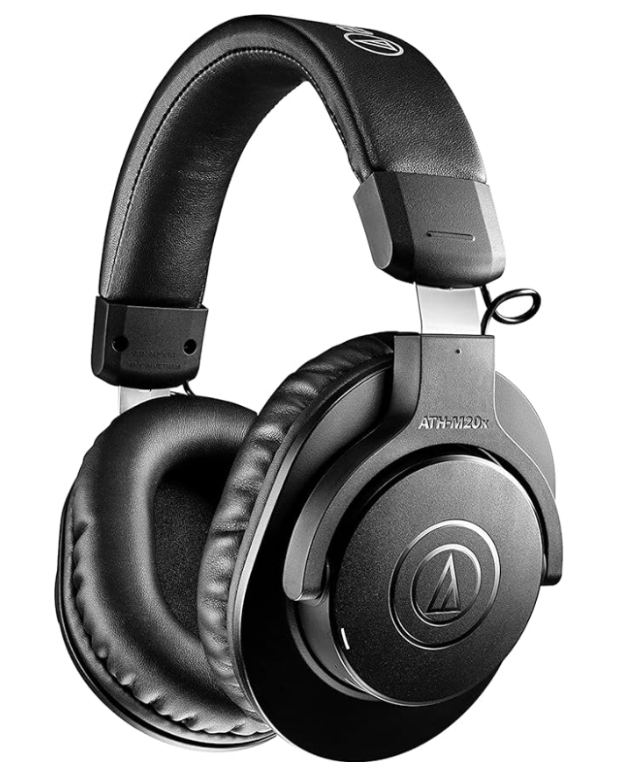
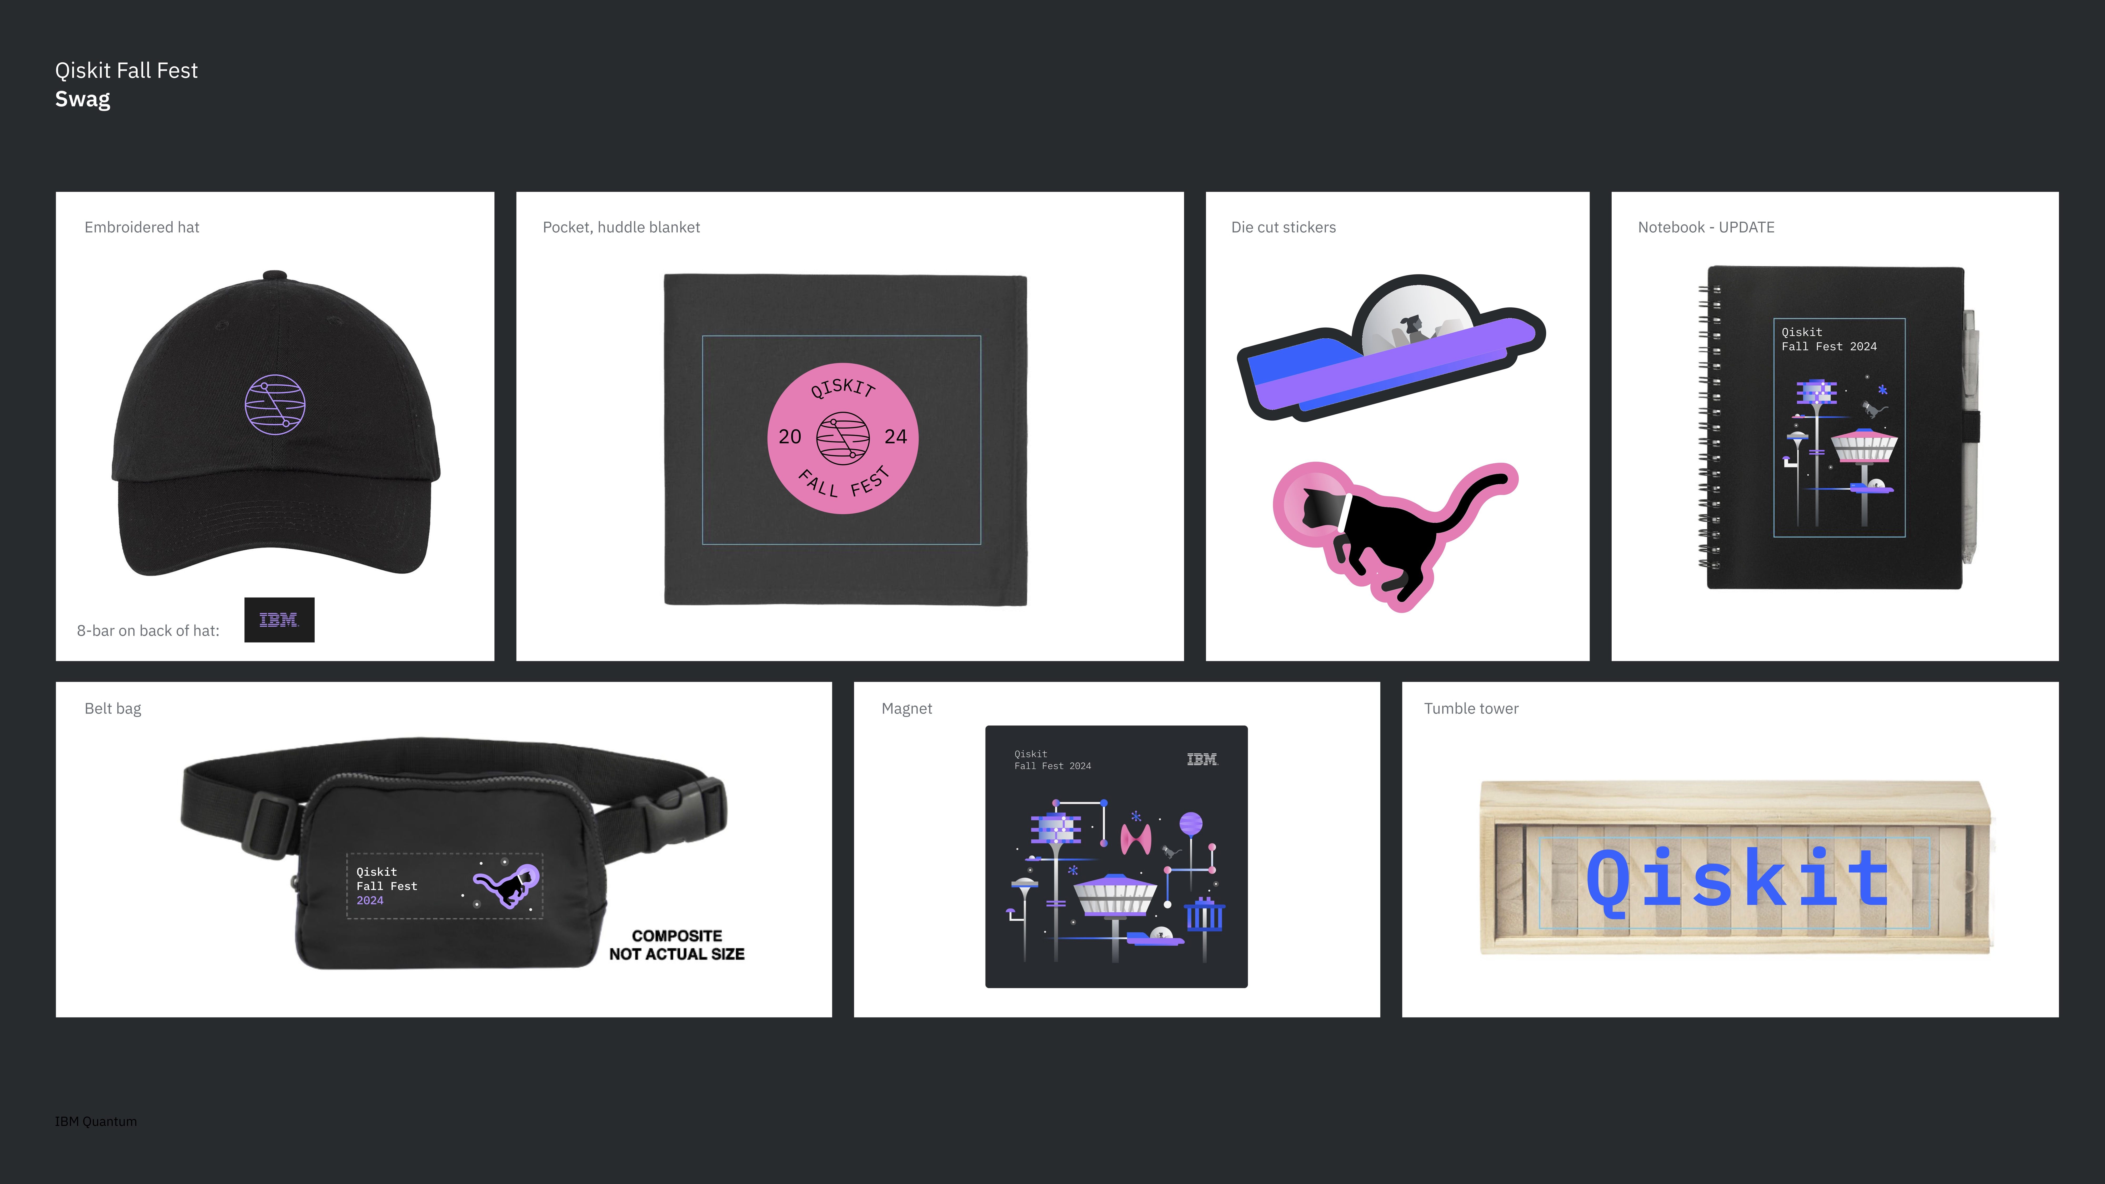
Prizes
First person to complete all 3 challenge notebooks
IBM swag-pack
6-in-1 Portable Charger
First place winner of the open-ended Qiskit Project:
Amazon Fire 8 Tablet & IBM Swag Pack
Audience favorite open-ended Qiskit Project
Bluetooth Headphones & IBM Swag Pack
Challenge notebook raffle
IBM swag
(Challenge notebook submissions will be entered into a raffle, with easy, medium and advanced notebooks giving you 1, 2, and 3 raffle entries, respectively.
Notable mentions from the open-ended Qiskit Project submissions.
IBM swag
Random giveaways
IBM Swap

Slide 6
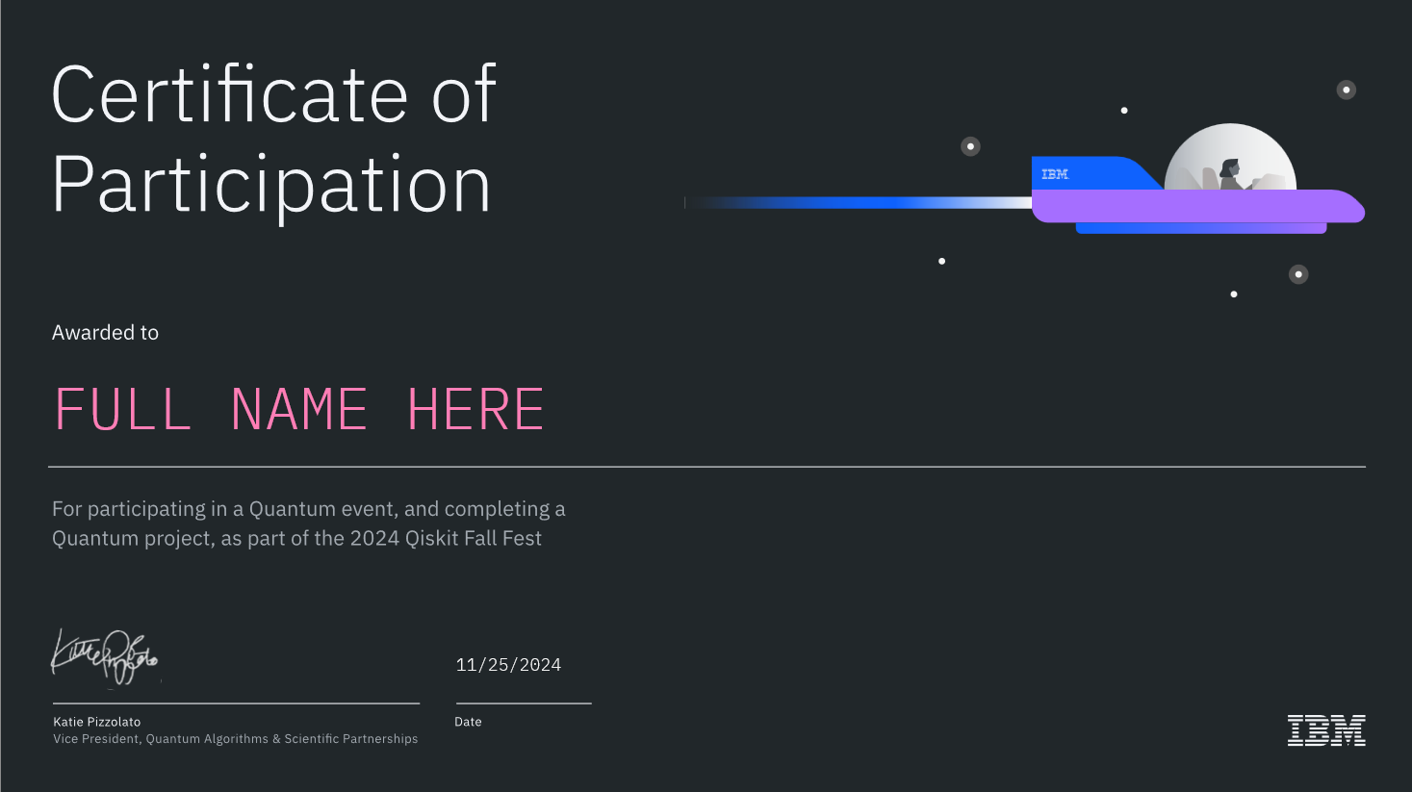
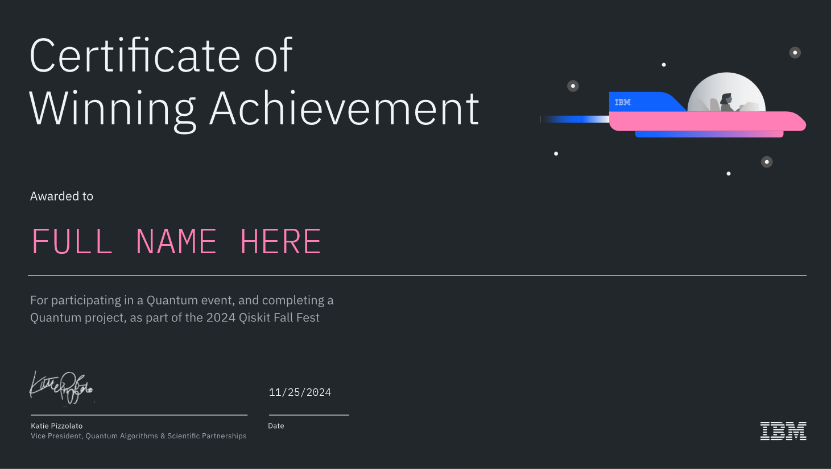
Certificates
Certificate for completing at least Qiskit Challenge Notebook 1, and attendance at today’s kickoff & IBM Speaker Closing Event next week
Special certificate for open-ended Qiskit project hackathon winners!
Certificates will be delivered after the Awards Ceremony.

Slide 7
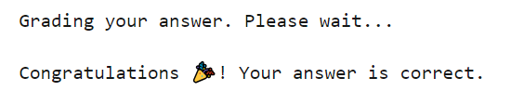
Qiskit Challenge Notebooks
Three challenge notebooks that get progressively more difficult.
“Completion” means you have finished all exercises, and the grader has returned this message for each:

Slide 8

Qiskit Challenge Notebook Submission
Complete at least Notebook 1
Upload your completed notebooks to Github
Beginner's Guide to GitHub
Beginner's Guide to Git
Submit the Google Form your Github repository link
Deadline: Nov 7 at 11:59pm

Slide 9
Open-ended Qiskit Project Requirements
The project must be completed using Qiskit.
Ideally the project can be your own design, but we have officla IBM prompts if you can’t come up with an idea. Plagiarized code, or projects that are too similar to other freely available projects will be disqualified.
The project must be uploaded to Github and submitted via Devpost.
To be eligible for prizes, you must be willing to present your project at the Qiskit Fall Fest Closing Ceremony on Thursday, November 14th from 7:00-8:00pm.

Slide 10
Open-ended Qiskit Project Scoring
Comments:
Points | 0-1 | 2-3 | 4-5 | 6-7
Completeness | Incomplete: The project is missing several key elements and is not functional in its current state. | Barely Functional: The project is operational but lacks many components that are crucial for it to work as intended. | Mostly Complete: The project includes most of the necessary parts, and functions with few issues. | Fully Functional: The project is complete with all necessary components to function seamlessly.
Creativity | Unoriginal: The project recycles existing ideas without any unique additions or creative engagement. | Mildly Creative: The project shows some minor creativity, but it largely relies on existing ideas. | Creative: The project introduces innovative ideas or approaches, building upon existing concepts in an interesting way. | Highly Creative: The project stands out with original ideas and a unique, inventive approach that differentiates it significantly from existing projects.
Technology | Basic: The project utilizes fundamental methods or technologies, with no evidence of complexity or challenge. | Moderate: The project includes some sophisticated methods or technologies, but they are underutilized or poorly implemented. | Advanced: The project employs complex methods or technologies effectively, although with some room for improvement. | Cutting-Edge: The project pushes the boundaries by successfully implementing sophisticated, challenging methods or technologies to their fullest extent.
Presentation | Poor: The project’s presentation is unorganized or unclear, lacking both aesthetic appeal and clarity in communication. | Fair: The project’s presentation is somewhat organized and clear, with minimal aesthetic appeal and satisfactory communication. | Good: The project is well-presented, with attention to aesthetic details and clear, effective communication. | Excellent: The project’s presentation is highly professional, aesthetically captivating, and communicates the vision and idea with exceptional clarity.

Slide 11
IBM Prompts
Comments:
Beginner Prompt
Random Number Generator
Intermediate Prompt
Quantum Circuit Transpilation
Advanced Prompts
Using Dynamic Circuits
Real-World Applications
Notes:
Transpilation allows us to convert a quantum circuit to a set of executable gates. Making your own transpiler plugin.
Dynamic circuits incorporates quantum circuits with real-time classical communication. Real World-Applications: Variational algorithm design, solving utility-scale quantum optimization problems, or quantum computing in practice playlist.

Slide 12
Open-ended Qiskit Project Submission
Complete the project and upload it to Github
Write relevant documentation and README files
Create a short video demonstrating your project
Submit your project to Devpost
Deadline: Thursday, Nov. 7th at 11:59pm
Prepare your demo for the
Closing Ceremony

Slide 13
Resources!
Our wonderful mentors – thank you!
Use all the online resources at your disposal
https://qiskit.org/learn
https://qiskit.org/documentation/tutorials.html
Video tutorial
https://learning.quantum-computing.ibm.com/
https://qiskit.org/documentation/tutorials/circuits/1_getting_started_with_qiskit.html

Slide 14
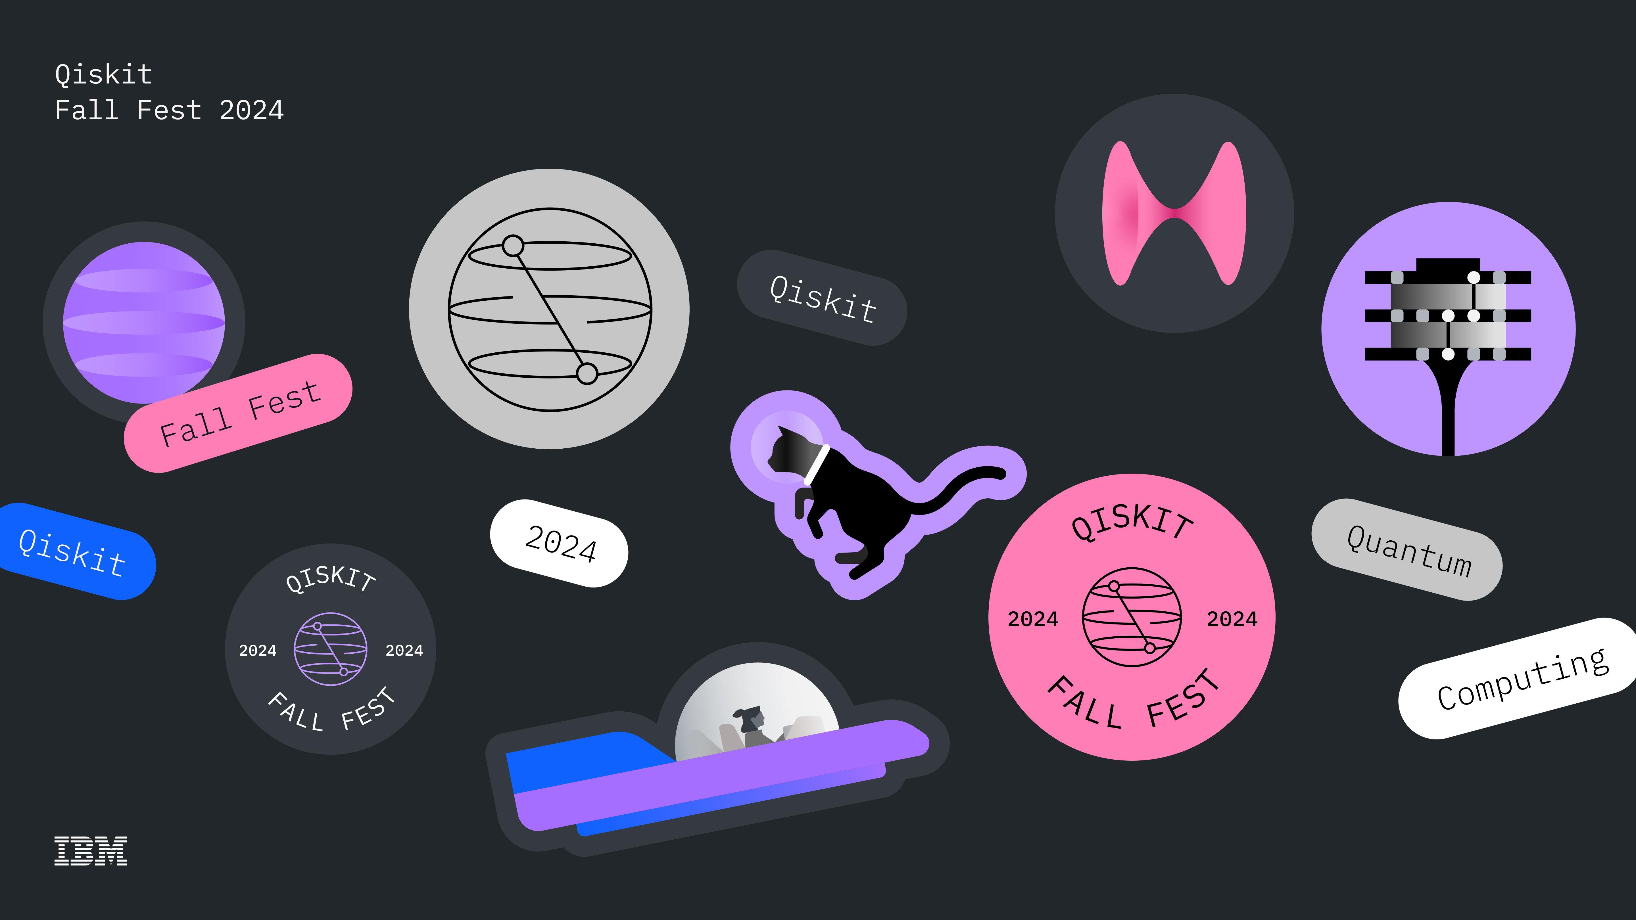

Have fun!
Quantum Hackathon

